Slide 1
MIT Virtual Source Model
By
Saurav Thakur

Slide 2
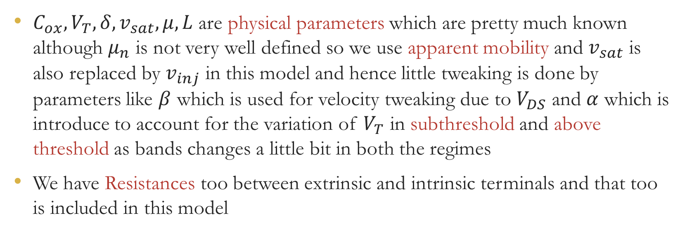
Parameters on which MIT VS model depends
$C_{ox},V_{T}, δ,v_{sat},μ, L$ are physical parameters which are pretty much known although $μ_{n}$ is not very well defined so we use apparent mobility and $v_{sat}$ is also replaced by $v_{inj}$ in this model and hence little tweaking is done by parameters like $β$ which is used for velocity tweaking due to $V_{DS}$ and $α$ which is introduce to account for the variation of $V_{T}$ in subthreshold and above threshold as bands changes a little bit in both the regimes
We have Resistances too between extrinsic and intrinsic terminals and that too is included in this model

Slide 3
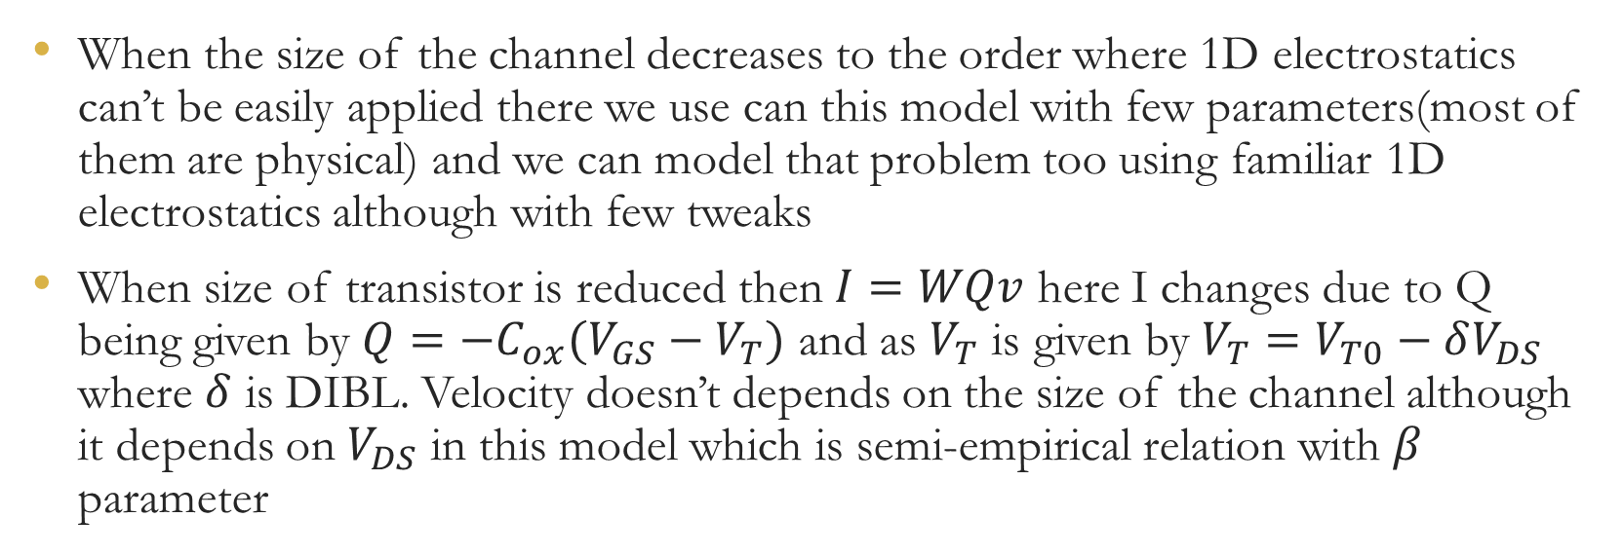
Description of Charge model of MVS
When the size of the channel decreases to the order where 1D electrostatics can’t be easily applied there we use can this model with few parameters(most of them are physical) and we can model that problem too using familiar 1D electrostatics although with few tweaks
When size of transistor is reduced then $I=WQv$ here I changes due to Q being given by $Q=−C_{ox}(V_{GS}−V_{T})$ and as $V_{T}$ is given by $V_{T}=V_{T0}−δV_{DS}$ where $δ$ is DIBL. Velocity doesn’t depends on the size of the channel although it depends on $V_{DS}$ in this model which is semi-empirical relation with $β$ parameter

Slide 4
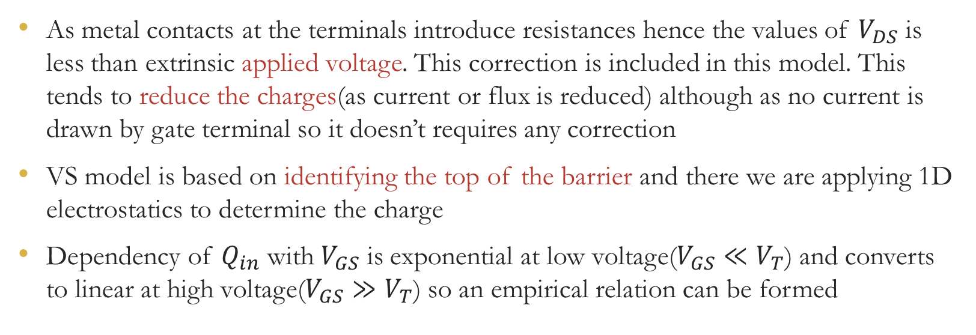
Description of Charge model of MVS
As metal contacts at the terminals introduce resistances hence the values of $V_{DS}$ is less than extrinsic applied voltage. This correction is included in this model. This tends to reduce the charges(as current or flux is reduced) although as no current is drawn by gate terminal so it doesn’t requires any correction
VS model is based on identifying the top of the barrier and there we are applying 1D electrostatics to determine the charge
Dependency of $Q_{in}$ with $V_{GS}$ is exponential at low voltage($V_{GS}≪V_{T}$) and converts to linear at high voltage($V_{GS}≫V_{T}$) so an empirical relation can be formed

Slide 5
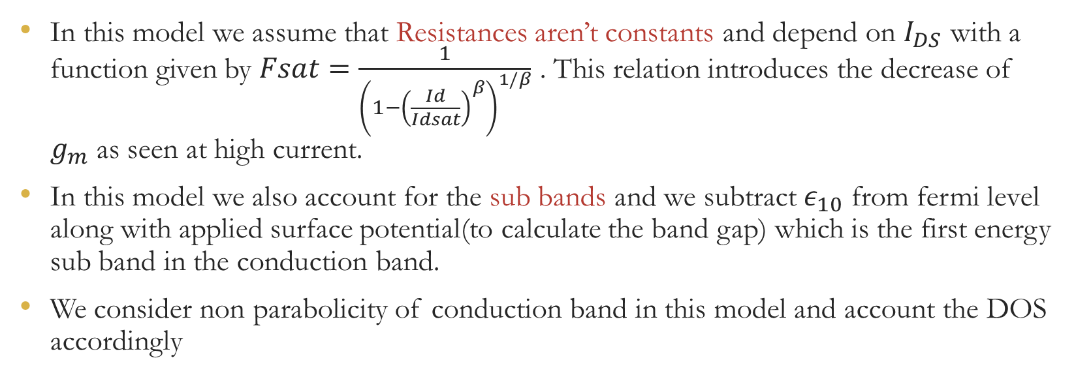
MVS Model 2.0.0
In this model we assume that Resistances aren’t constants and depend on $I_{DS}$ with a function given by $Fsat=\frac{1}{{\left(1−{\left(\frac{Id}{Idsat}\right)}^{β}\right)}^{1/β}}$ . This relation introduces the decrease of $g_{m}$ as seen at high current.
In this model we also account for the sub bands and we subtract $ε_{10}$ from fermi level along with applied surface potential(to calculate the band gap) which is the first energy sub band in the conduction band.
We consider non parabolicity of conduction band in this model and account the DOS accordingly

Slide 6
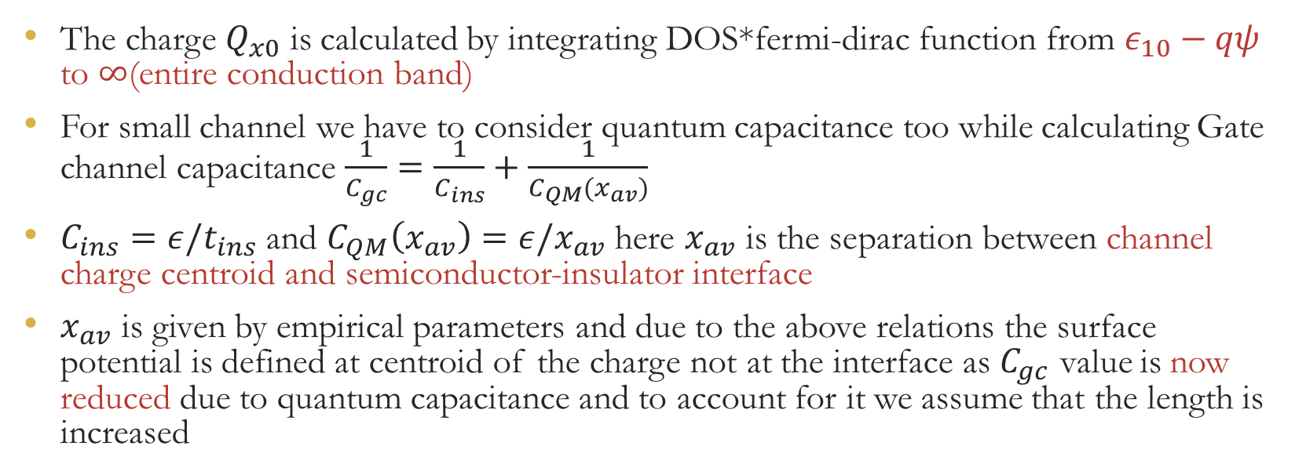
MVS Model 2.0.0
The charge $Q_{x0}$ is calculated by integrating DOS*fermi-dirac function from $ε_{10}−qψ$ to $∞$(entire conduction band)
For small channel we have to consider quantum capacitance too while calculating Gate channel capacitance $\frac{1}{C_{gc}}=\frac{1}{C_{ins}}+\frac{1}{C_{QM}(x_{av})}$
$C_{ins}=ε/t_{ins}$ and $C_{QM}\left(x_{av}\right)=ε/x_{av}$ here $x_{av}$ is the separation between channel charge centroid and semiconductor-insulator interface
$x_{av}$ is given by empirical parameters and due to the above relations the surface potential is defined at centroid of the charge not at the interface as $C_{gc}$ value is now reduced due to quantum capacitance and to account for it we assume that the length is increased

Slide 7
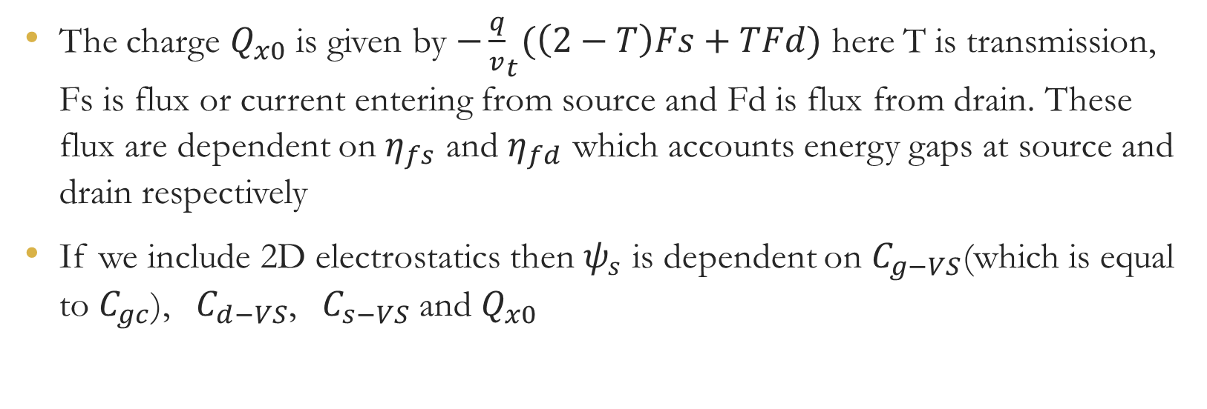
MVS Model 2.0.0
The charge $Q_{x0}$ is given by ${−\frac{q}{v}}_{t}(\left(2−T\right)Fs+TFd)$ here T is transmission, Fs is flux or current entering from source and Fd is flux from drain. These flux are dependent on $η_{fs}$ and $η_{fd}$ which accounts energy gaps at source and drain respectively
If we include 2D electrostatics then $ψ_{s}$ is dependent on $C_{g−VS}$(which is equal to $C_{gc}$), $C_{d−VS}$, $C_{s−VS}$ and $Q_{x0}$

Slide 8
THANK YOU

